Slide 1
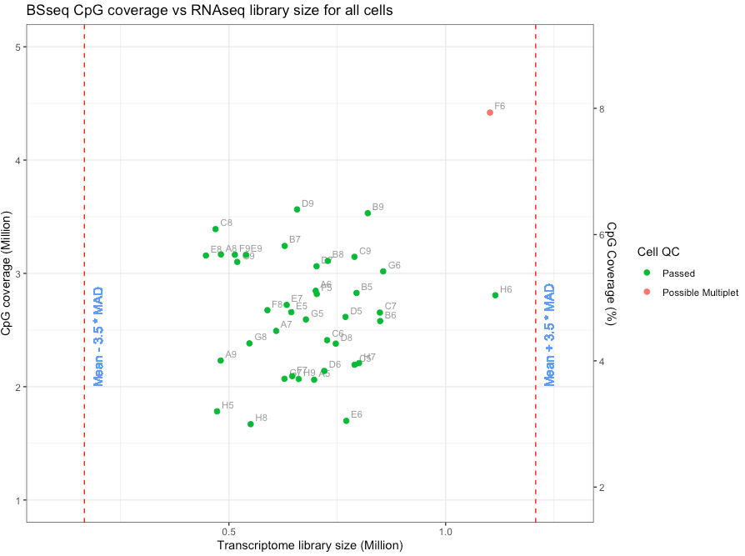
Bsseq Data
Cell QC
Total CpG content calculated as twice the top strand CpGs for whole genome and genomic contexts
CpG Coverage vs Transcriptome Library Size – matching cells
No outliers in terms of transcriptome library sizes
Average CpG coverage of ~ 5%
Average Transcriptome library size ~ 6.9 M

Slide 2
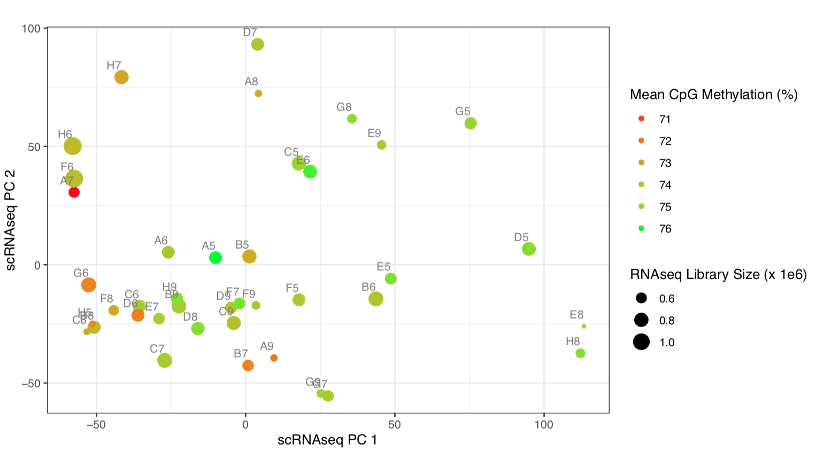
Association b/w global methylation and transcriptome?

Slide 3
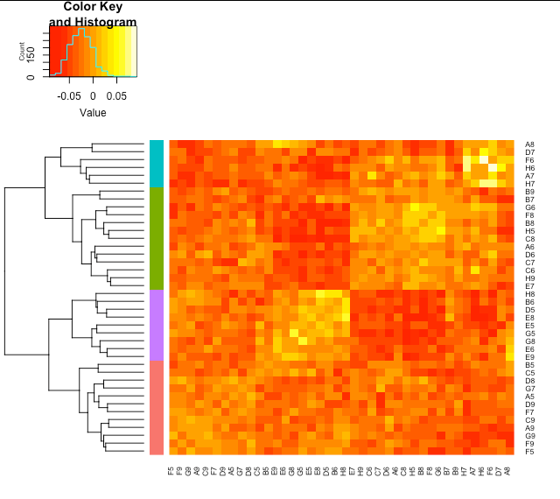
Transcriptome Data
Question: Is that heterogeneity in transcriptome data associated with the heterogeneity in the BSseq data?
Hierarchical clustering of transcriptome cells and grouping the cells into 4 clusters as reference for BSseq analysis
Notes:
To see where we can expect more meaningful associations within contexts

Slide 4
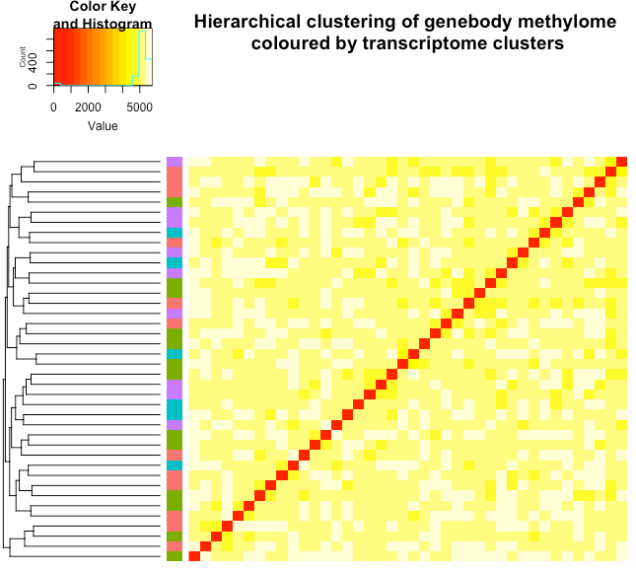
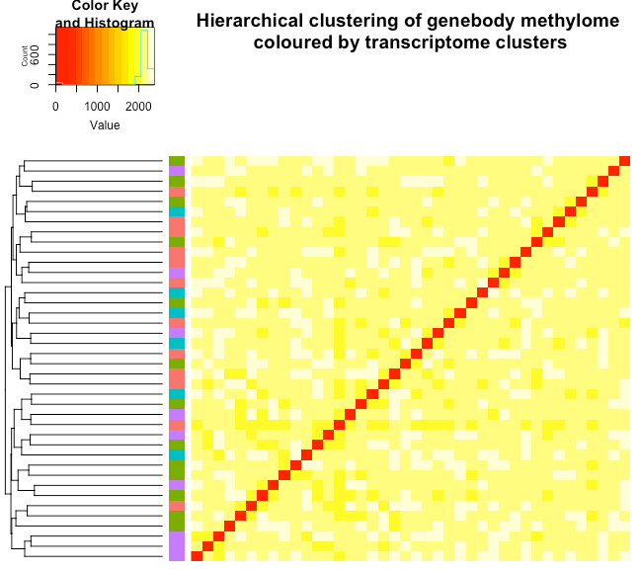
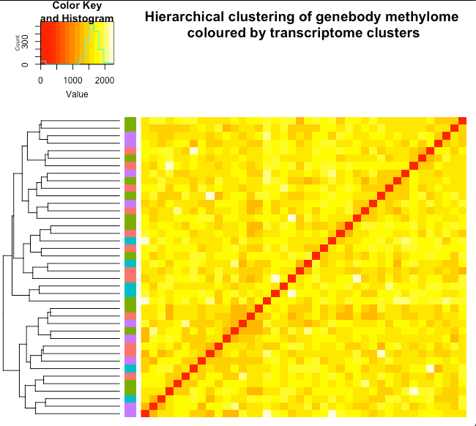
Bsseq Data
The transcriptome clusters are not recapitulated in BSseq data.
The colour codes represent clusters in transcriptome data.

Slide 5
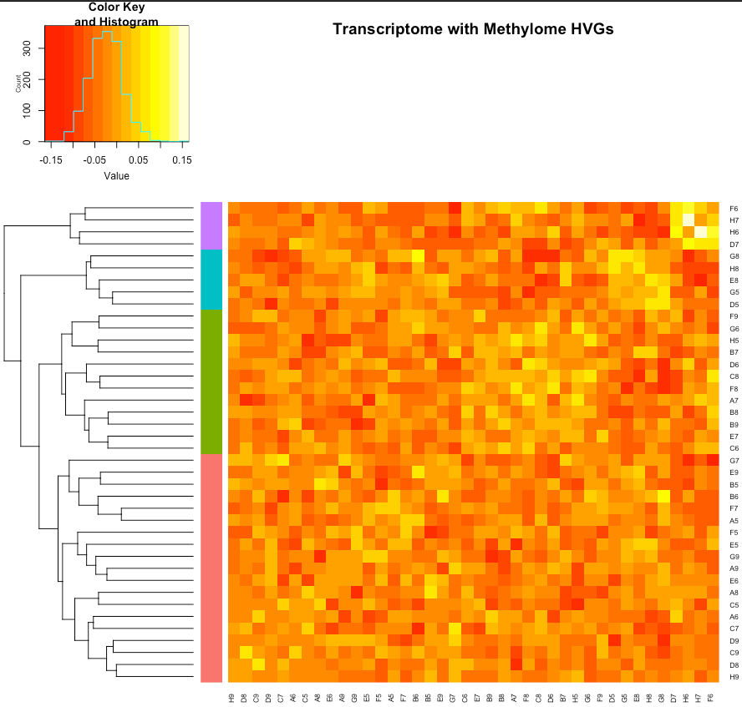
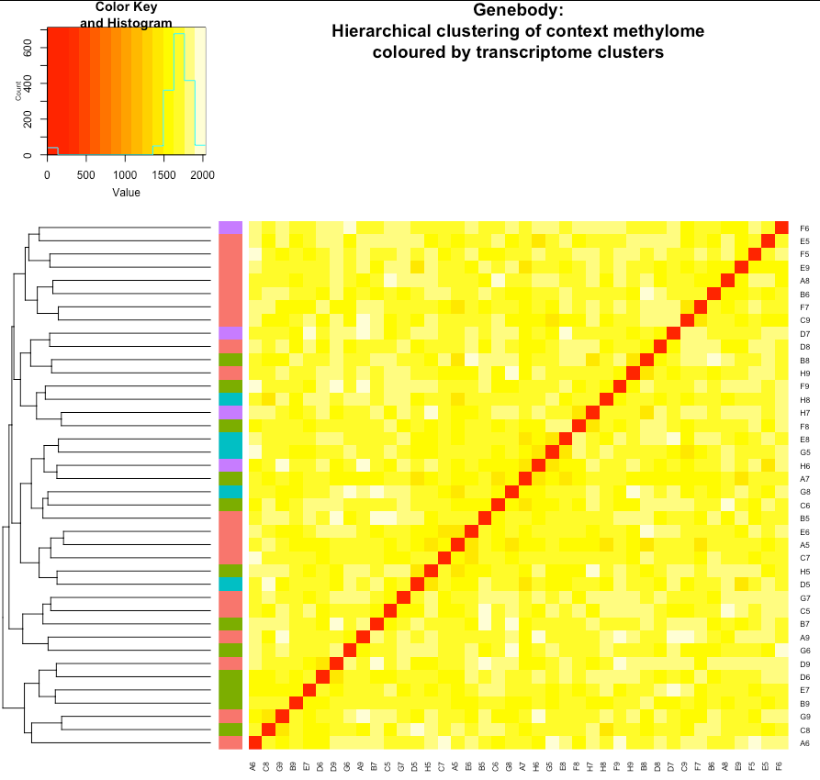
Genebody
Transcriptome clusters using methylome HVGs as reference
Hierarchical clustering of transcriptome using 1000 methylome HVGs
Hierarchical clustering of genebody methylome using genebody methylome HVGs coloured by transcriptome clusters when considering genebody methylome HVGs

Slide 6
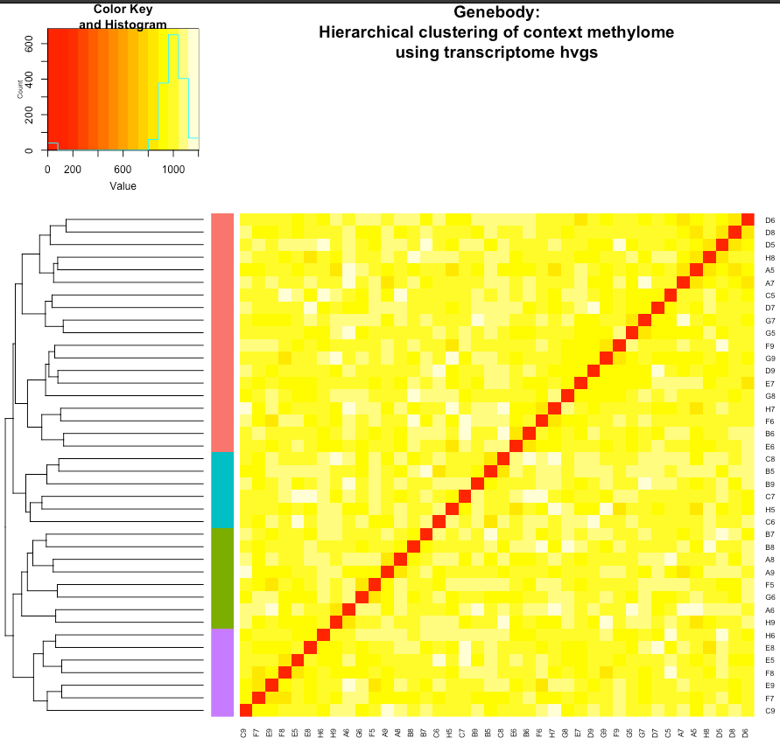
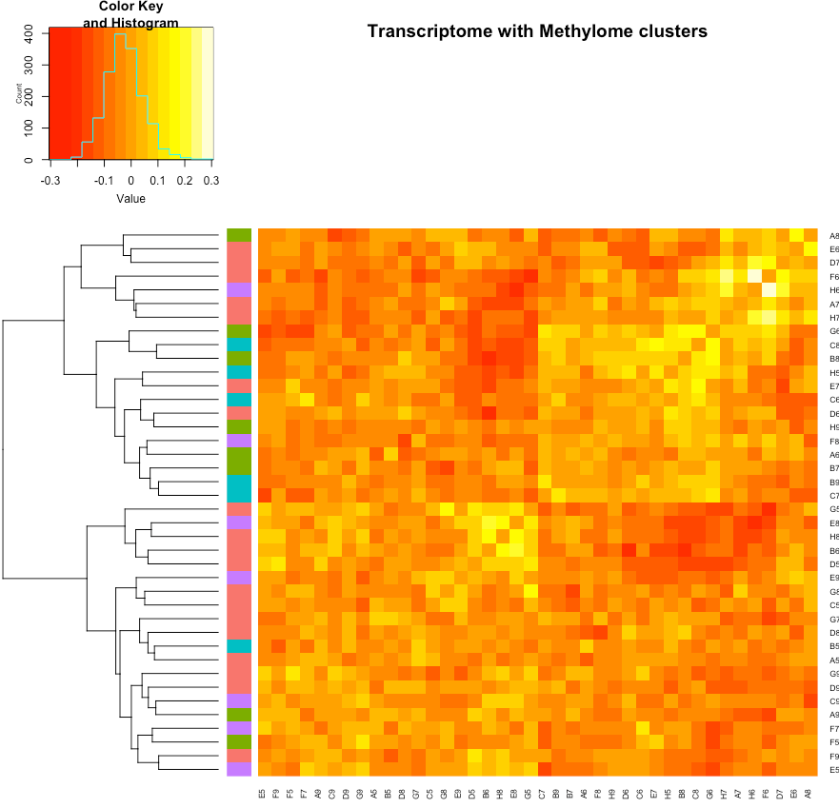
Genebody
Methylome clusters using transcriptome HVGs as reference
Hierarchical clustering of genebody methylome using transcriptome HVGs
Hierarchical clustering of transcriptome using HVGs and colour coding using genebody methylome clusters
Notes:
Low variation in methylome data

Slide 7
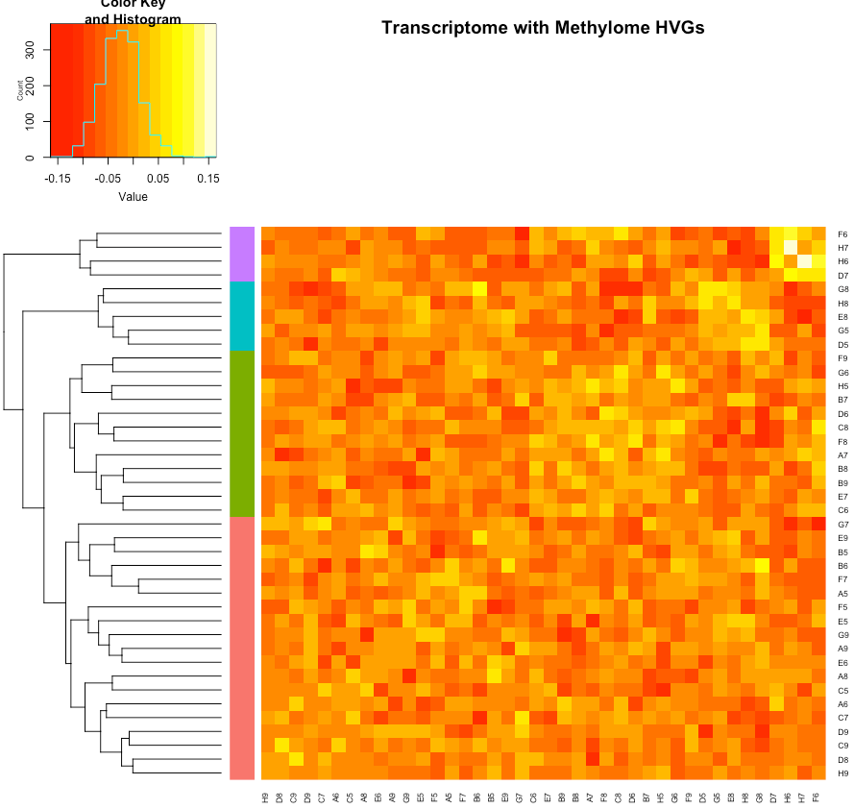
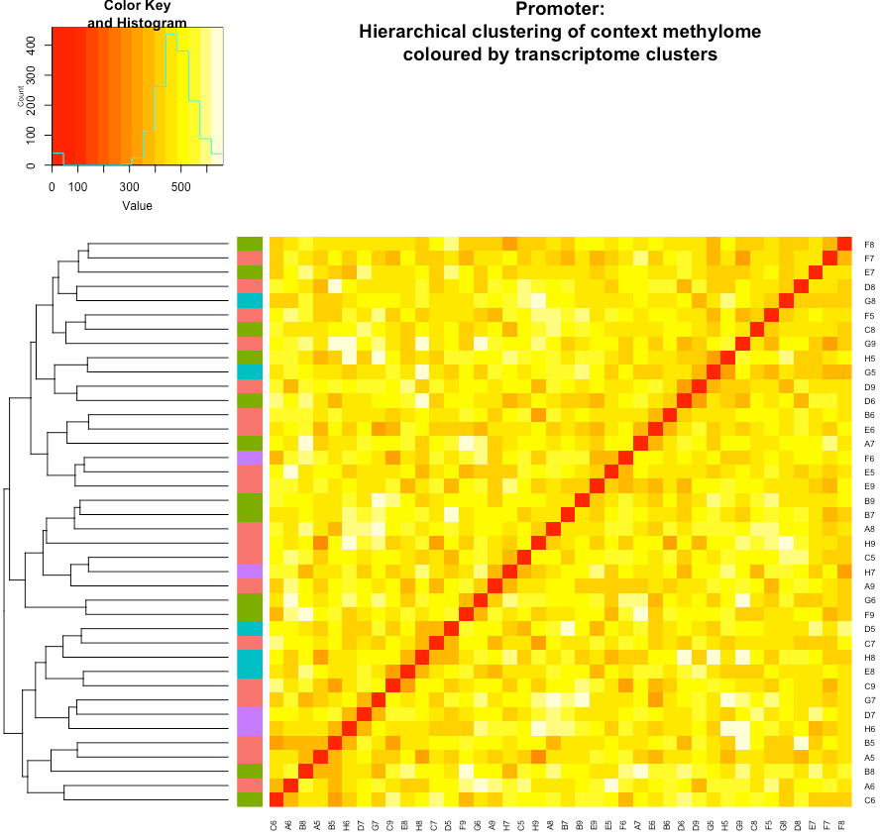
Promoter
Transcriptome clusters using methylome HVGs as reference
Hierarchical clustering of transcriptome using 1000 methylome HVGs
Hierarchical clustering of promoter methylome using promoter methylome HVGs coloured by transcriptome clusters when considering promoter methylome HVGs

Slide 8
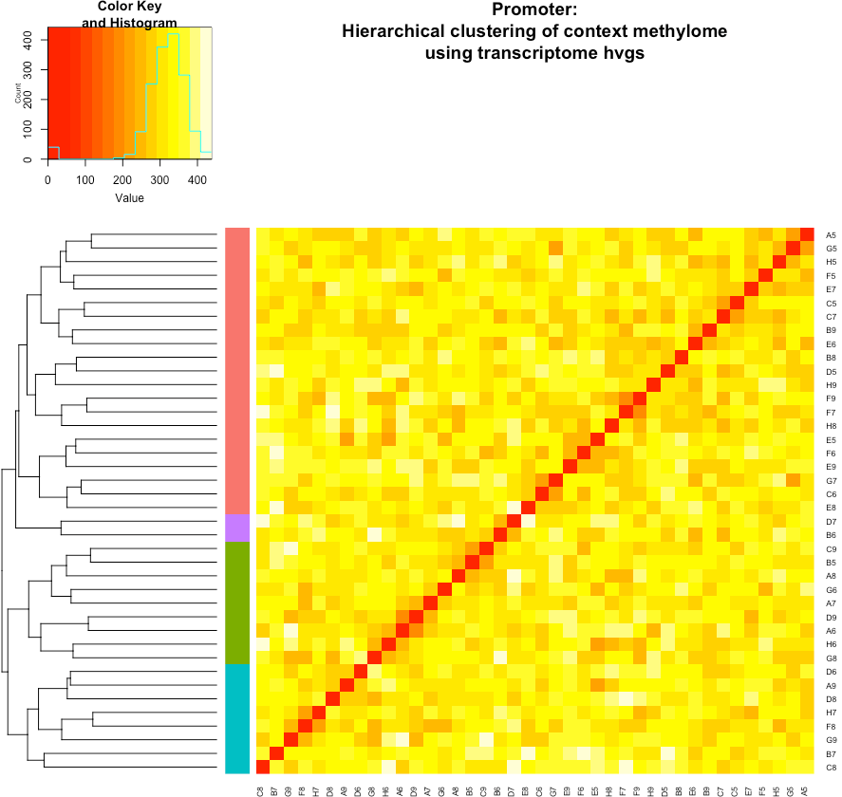
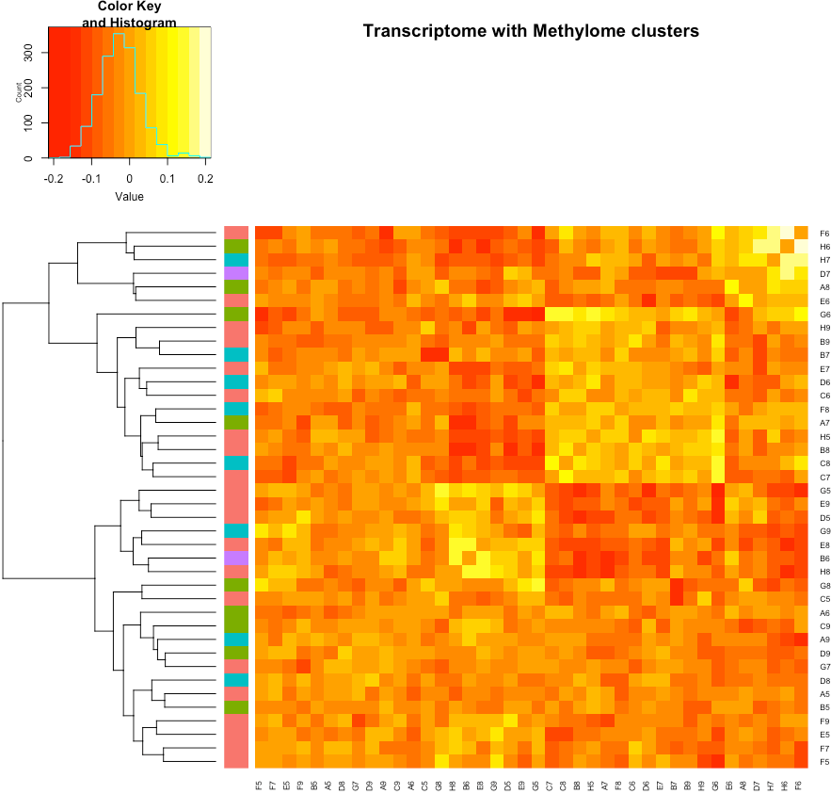
Promoter
Methylome clusters using transcriptome HVGs as reference
Hierarchical clustering of promoter methylome using transcriptome HVGs
Hierarchical clustering of transcriptome using HVGs and colour coding using genebody methylome clusters
Notes:
Low variation in methylome data

Slide 9
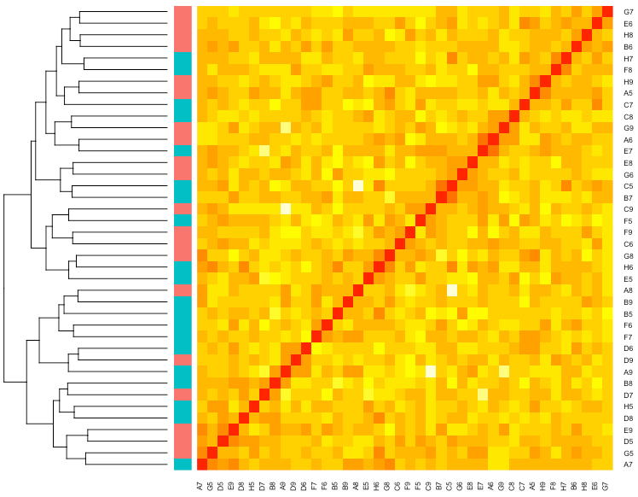
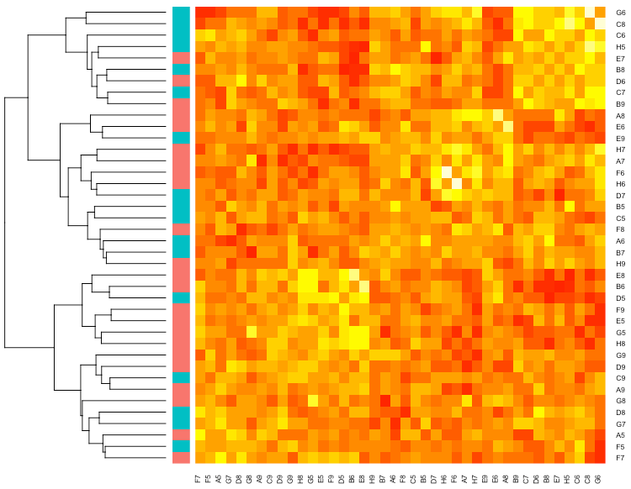
Reduce clusters to 2.
Hierarchical clustering of genebody methylome using genebody methylome HVGs coloured by transcriptome clusters when considering genebody methylome HVGs
Hierarchical clustering of transcriptome using transcriptome HVGs coloured by methylome clusters when considering transcriptome HVGs

Slide 10
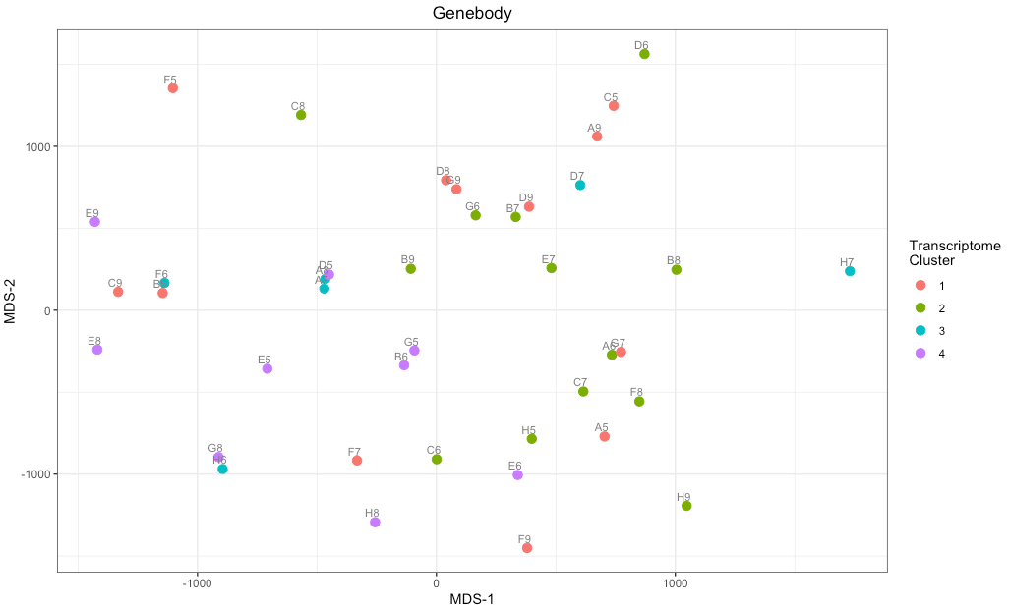
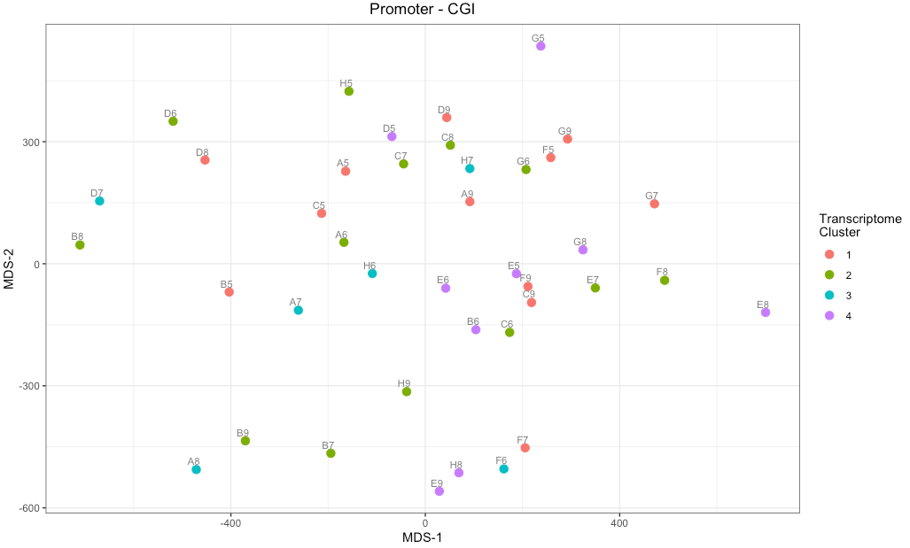
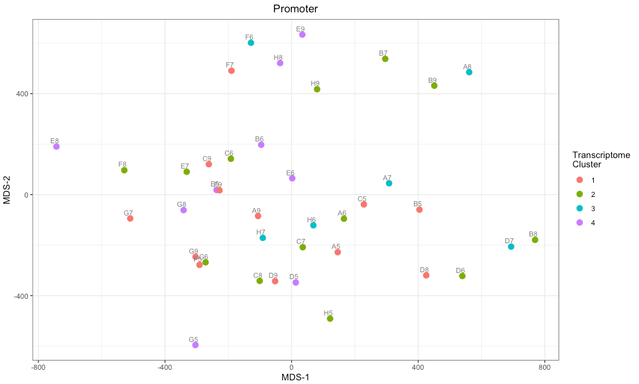
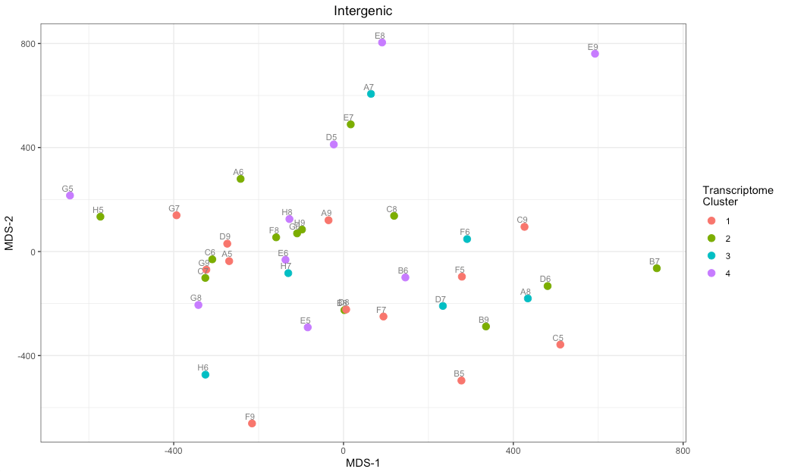
Variation in methylation by context – 4 clusters for transcriptome

Slide 11
Cell QC
Total CpG content calculated as twice the top strand CpGs for whole genome and genomic contexts
CpG Coverage vs Transcriptome Library Size – matching cells
No outliers in terms of transcriptome library sizes
Average CpG coverage of ~ 5%
Average Transcriptome library size ~ 6.9 M

Slide 12
CpG Coverage by Genomic Context
Total CpG content calculated as twice the top strand CpGs for whole genome and genomic contexts
The proportion of sites covered is the highest in promoter located at CGI regions.
Proportion of CpG sites covered
Number of CpG sites covered (log scale)

Slide 13
Methylation rate and heterogeneity by Genomic Context
Capture bias accounted for by using MAP used for methylation rate and lower bound of variance 95th %-tile confidence interval.
The bimodality in promoter regions explained by whether or not they are located in CGI regions, with CGI promoters being hypomethylated.
As expected, intergenic regions are hypermethylated.
Variance in methylation rate
Average methylation rate

Slide 14
Pairwise correlation b/w methylation and expression
Pearson correlation used – while Spearman also produced similar results
Considering all genes
Intergenic regions ignored as they do not match to a single gene
Near zero median correlation
Pairwise Pearson correlation across all genes

Slide 15
Correlation b/w heterogeneity in methylation and expression
A single value calculated - height of column indicates the magnitude
Lower bound of variance confidence intervals used
The Non-CGI promoter regions most affected by technical variation.
The heterogeneity in methylation
Considering total variance
After accounting for technical noise

Slide 16
Correlation b/w heterogeneity in methylation and expression
Questions: Are the correlations being affected by outliers from methylation variance data?
Look at interquartile regions from the methylation variance separately
Rather consistent positive correlation b/w heterogeneity b/w the two datasets when accounting for technical variation.
p-values can be affected by small sample size as well.
Considering total variance
After accounting for technical noise

Slide 17
sPLS - Promoter
Genes on main spls component are characterized by negative correlation b/w their promoter methylome and transcriptome.
Notes:
The interquartuile region is entirely in the nagtive
Not sure if GO enrichment of these genes can be insightful/meaningful

Slide 18
sPLS - Promoter
Pairwise correlations for signature genes from each dataset only
Transcriptome
Promoter Methylome
spls_out$prom$comp_1$RNAseq
spls_out$prom$comp_1$BSseq
spls_out$prom$comp_2$Bsseq
Notes:
The interquartuile region is entirely in the nagtive
Not sure if GO enrichment of these genes can be insightful/meaningful

Slide 19
sPLS - Genebody
Genes on main spls component are characterized by positive correlation b/w their methylome and transcriptome.
Notes:
- The genebody signature genes correlate positively and for them, the correlations for CGI and non-CGI promoters behave opposite

Slide 20
sPLS - Genebody
Pairwise correlations for signature genes from each dataset only
Transcriptome
Genebody Methylome
Notes:
- The genebody signature genes correlate positively and for them, the correlations for CGI and non-CGI promoters behave opposite

